Slide 1


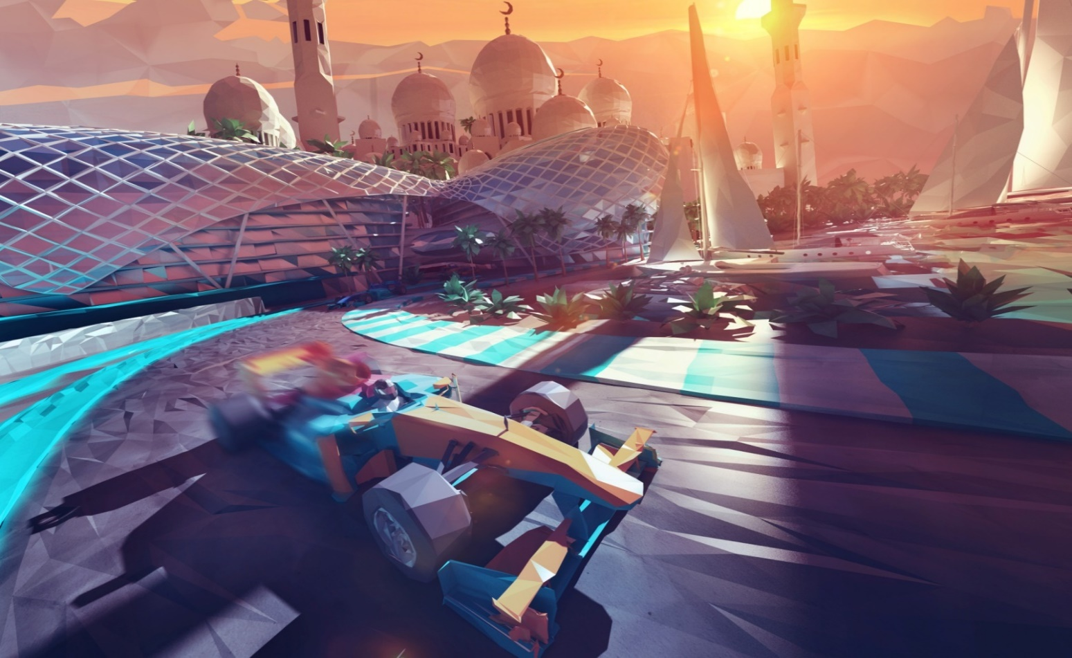
Your 4-day Experience in
Abu Dhabi
Culture, Heritage & Relaxation

Slide 2
The Itinerary
Day | Morning |  | Afternoon |  | Evening
Day 1 | Time | Schedule | Time | Schedule | Time | Schedule
 | 8:00 | Arrival into Abu Dhabi Airport and proceed with Half Day Abu Dhabi City Tour | 13:00 - 15:00 | Friday Hakka Brunch at Emirates Palace |  | Relax at the pool
 | 10:30 - 12:30 | Places of Visit: Sheikh Zayed Mosque Qasr Al Watan | 16:00 | Check in at hotel of choice |  | Dinner at Marcos (if staying at Fairmont)
Day 2 | Time | Schedule | Time | Schedule | Time | Schedule
 | 8:00 | Breakfast | 13:30 | Lunch at the W hotel | 18:00 | Dinner and drinks at Filini
 | 10:00 - 13:00 | Falcon Hospital Visit | 15:00 - 17:00 | Yas Marina Circuit Activiites
Day 3 | Time | Schedule | Time | Schedule | Time | Schedule
 | 8:00 | Breakfast | 12:30 | Lunch at Marcos at Fairmont Bab Al Bahar | 18:00 | Dinner at Buddha Bar Beach Club
 | 9:00 - 11:30 | Kayak around the Louvre Abu Dhabi or Tour of Louvre Abu Dhabi | 14:00 | Leisure time at Souq Qaryat Al Beri |  | Optional drinks after Dinner (not priced in package)
Day 4 | Time | Schedule | Time | Schedule | Time | Schedule
 | 8:00 | Breakfast and check-out from hotel | 12:00 - 13:30 | Lunch at Cipriani | 21:30 | Drinks at the desert hotel (Al Wathba)
 | 9:30-11:30 | Pearl Diving Experience | 14:00 | Check-in at a Wathba Desert Resort
 |  |  | 15:00 - 21:00 | Pick-up for Hala Oasis (desert sunset drive) Activities: Dune Bashing, Shisha, Henna hand-painting, Arabic-themed dinner
Day 5 | Time | Schedule | Time | Schedule | Time | Schedule
 | 5:00 | Departure to Abu Dhabi Airport

Slide 3
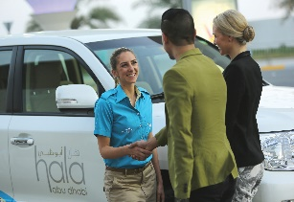
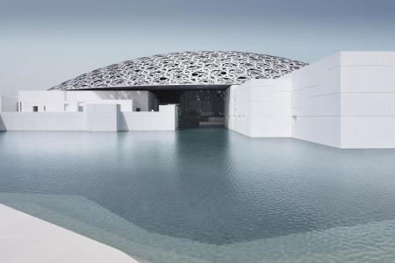
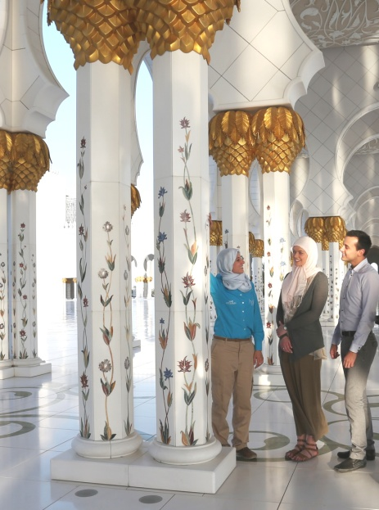
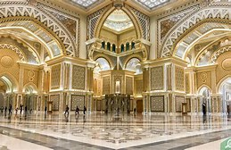
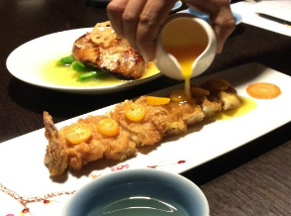
Day 1
Culture & Heritage
When you begin exploring the cultural and heritage attractions of Abu Dhabi, you will quickly discover that this is a destination where respect for the past informs the present and shapes the future. Across the vibrant Emirate, you will discover more than 700 kilometers of beautiful coastline, stunning natural islands, picture perfect deserts, oases and mountains. These attractions will give you a true insight into the wonderful traditions of the Arabian culture!
MORNING | Upon arrival at Abu Dhabi international airport, you will be met, welcomed and assisted by specially chosen Etihad Experiences Guest Guide and walks you through Abu Dhabi’s rich history, culture and heritage. Drive into the city to get a glimpse of the grandest mosque, the Sheikh Zayed Mosque and leisurely tour the white shiny domes which comprises of 832, golden colonnades and features stunning flower inlays across its marble walls and flooring. Pictures are allowed and there are a number of great vistas. Remember that this is a religious site and the dress code includes long, loose fitting shirts and ankle length trousers and skirts as well as headscarves for women. Transfer to the incredible Qasr Al Watan, the Presidential Palace in Abu Dhabi. It is a new and unique landmark in the Middle East where governing traditions and values are brimming with its well-preserved legacy of knowledge offering the world a first-of-its-kind insight into the Arab heritage.
AFTERNOON | After the tour of the country’s history and culture, indulge yourself with a regal Cantonese feast fit for a king or a queen in a brunch at Hakkasan. From the stunning venue with its impressive outdoor terrace overlooking the Abu Dhabi’s skyline, to the chilled ambiance, top service and brilliant food at Emirates Palace, a five star luxury hotel the brunch definitely would be one of your most unforgettable gastronomic experience. Check-in at your the hotel of choice.
EVENING | Satisfy your craving at Fairmont Bab Al Bahar’s Marco’s New York Italian menu. A thoughtful combination of Italian home-style options from sharing platters and seafood to succulent steaks, freshly-baked pizzas and pastas; complemented by American classics including New Orleans steaks and the Great American Beef Burger. Or have your dinner at your preferred restaurant where you have booked your stay.

Slide 4
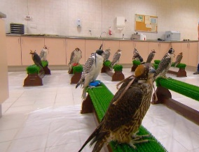

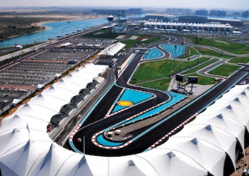
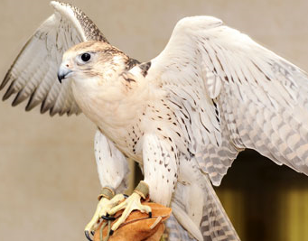
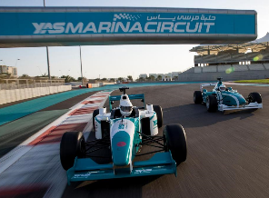
Day 2
Traditions & Entertainment
A day of excitement and experiences: driving at the world famous Etihad Airways’ Abu Dhabi F1 Grand Prix circuit and a visit at the country’s falconry and its museums that houses a variety of birds passing through the facility.
MORNING | See for yourself the Abu Dhabi Falcon Hospital, world’s first and largest hospital dedicated to the Falcon, the UAE’s national bird. It is an award-winning with most advanced technology for falcons, the national’s emblem and birds. It has 6,000 birds pass through each year occupying the 200 air-conditioned treatment rooms. You will tour the facility with a host tourist guide and provide unique insight into the history of the sport of falconry that has deep roots on the nation’s culture and the physiology of the valuable birds which are issued with passports to get access to the high-quality check-ups, treatments and feather substitution. Witness a falcon pedicure and even take pictures as you make friends with the birds as one perch on your arm. Have lunch at the only 5-star hotel in Yas Island – W Hotel that offers wide array of cuisines that suits your craving.
AFTERNOON | For motorsport lovers, the activities at Yas Marina Circuit lets give you a glimpse of a unique opportunity to experience the thrill of driving on the Etihad Airways Abu Dhabi Grand Prix F1 racetrack. All car and race enthusiasts will be thrilled by this variety of half day driving experiences. Try F3000 style single-seater or Aston Martin Sports Cars or for the ultimate thrill ride in the passenger seat of a Formula 1 race car driven by a professional driver. - Aston Martin GT4 or F1 style race car track drive. Or take a venue tour and go behind the scenes of one of the world’s most advanced Formula 1 circuits.
EVENING | Dinner and drinks at Filini Garden, Radisson Blu Yas Back to the hotel

Slide 5
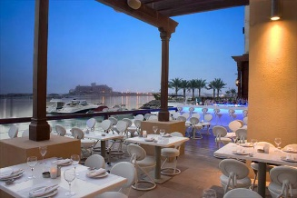
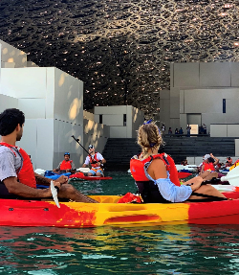
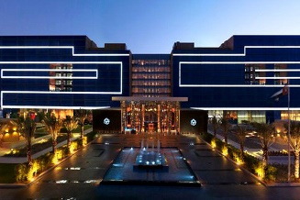
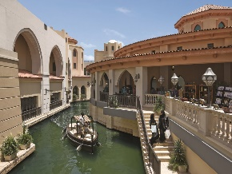
Day 3
Culture & Heritage
A continuation on the discovery of the Arabian arts and cultures, the galleries and museums in the capital’s cultural district, Saadiyat Island and wander around one of Abu Dhabi’s contemporary souq.
MORNING | Enjoy the museum from the stillness of the Arabian Sea and take a tour on a kayak to learn all about Louvre Abu Dhabi’s stunning architecture from a unique perspective. It is approximately 24,000 square metres in size, with 8,000 square metres of galleries, making it the largest art museum in the Arabian peninsula. Each tour will last for 60 minutes and all guests will be accompanied by professional instructors and given a safety and paddle briefing prior to the tour. There are changing rooms available near the kayaking meeting point and the activity will depend on weather conditions, sessions might be rescheduled or cancelled. In the event of cancellation, you will be notified.
AFTERNOON | A lunch dining experience that will satisfy any craving, Fairmont Bab Al Bahar’s Marco’s New York Italian menu is a thoughtful combination of Italian home-style options from sharing platters and seafood to succulent steaks, freshly-baked pizzas and pastas; complemented by American classics including New Orleans steaks and the Great American Beef Burger. Take a leisure walk at the Souq Qaryat Al Beri. “Souq” (souk) is an Arabic term for market or enclosed marketplace; a bazaar. The Qaryat Al Beri souk is a fusion of Arabian and Venetian themes with a stunning view of the Grand Mosque and the Grand Canal.
EVENING | Enjoy an evening at a beach bar in Saadiyat Island. Buddha-Bar Beach takes the urban brand al fresco and is open from morning until late. Maestro mixologists will concoct exquisite cocktails to complement its gastronomic treats, which blend Japanese and other pan-Asian flavors with a Mediterranean flair. Buddha-Bar DJs will also provide the perfect musical soundtrack to an unforgettable Abu Dhabi experience.

Slide 6
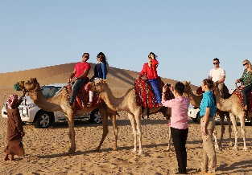
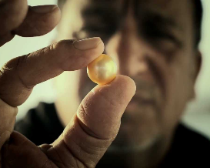
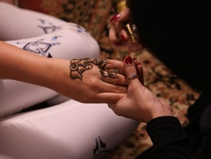
Day 4
Experience & Tranquility
Want to dive and look for pearls in an oyster like Emirati locals do? Or experience sand dune bashing deep in the heart of the Abu Dhabi desert?
MORNING | After breakfast, check-out from the hotel and proceed to Yas Marina on Yas Island for an authentic Arabian pearl diving expedition which takes you on a traditional dhow from Yas Marina, journeying to a dive site in search of pearls. Listen as the Captain (Nokhada) enthralls you with traditional pearl diving stories and sing along age-old Emirati pearling songs. You will learn the traditional pearling methods and be shown how to harvest real oyster shells from the depths of the Arabian Gulf. On the scenic return journey, you can learn techniques used by the boat’s “nokhada” or captain, to open their oysters and find the hidden treasures lying within. Find a Pearl, you keep it! Have lunch at Cipriani, a seafood restaurant by the Yas Marina that offers wide array of cuisines that suits your craving.
AFTERNOON | Check-in at Wathba Desert Resort, a luxurious 5-star resort with the touch of Arabian of hospitality. Nestled in the heart of the Arabian Desert in Abu Dhabi thus experiencing an intimate retreat suffused with natural beauty and serene tranquility. Starting from the hotel and into the discovery of Abu Dhabi’s desert with a gentle off-road drive through the sand dunes. Visit a camel farm and watch the magnificent sunset over the dunes. The journey will continue until we reach the traditional Arabic-themed camp, where you have the opportunity to try a host of activities such as henna painting, belly dancing and Shisha. Experience Arabic hospitality with Arabic coffee and dates as they have been served for centuries, and continue to be served in Emirati homes today. After sunset, a BBQ dinner will be served under the starlit sky. A live entertainment with a belly dancing performance will bring you into the world of 1001 nights before heading back to Abu Dhabi. Be assured that this safari will be a night to remember.
EVENING | Back to hotel for the overnight. Drinks at the hotel’s bar.

